Slide 1
CURRENT STATUS OF INDONESIAN EFFORT IN COMBATING ILLEGAL WILDLIFE TRADE
Jakarta June 22, 2016

Slide 2
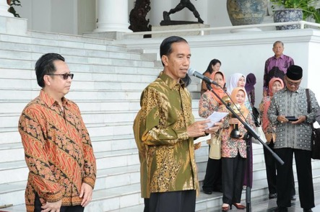
NEW INITIATIVES AND UPDATES
Political commitment by President of Republic Indonesia to crack down all environmental crimes offenders (including wildlife crime)
Scaling up the existing of Directorate of Investigation and Forest Protection into Directorate Generale of Environment and Forestry Law Enforcement under the new Ministry of Environment and Forestry.

Slide 3
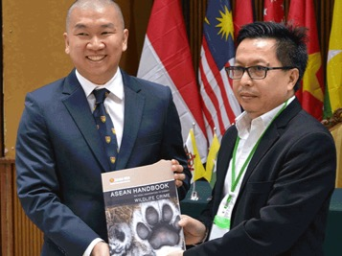
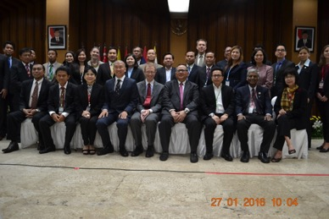
NEW INITIATIVES AND UPDATES
Workshop and Launching of the ASEAN Handbook on Legal Cooperation to Combat Wildlife Crime, held in Jakarta in January 2016
Launching of Information System Guideline on Forestry Crime and Money Laundering Crime, join project between Ministry of Forestry and Center of Financial Reporting, Analysis and Transaction (PPATK)

Slide 4
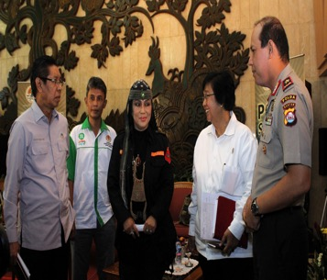
NEW INITIATIVES AND UPDATES
MoU signing between Indonesia National Police and MoEF on Capacity Building Cooperation
Finalizing of MoU between MoEF and General Attorney on Asset Recovery on Forest Crime (including wildlife crime)
Initiative on MoU development between MoEF and Indonesia National Police on Wildlife Crime Forensic
Finalizing of MoU between DG of Environment and Forestry Law Enforcement and Customs on join inspection

Slide 5
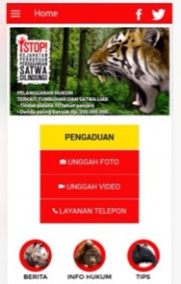
NEW INITIATIVES AND UPDATES
Launching of Environment and Forestry Law Enforcement Apps.
Development of Analytical Room on Environment and Forestry Crime at Directorate General of Environment and Forestry Law Enforcement, MoEF
Finalizing of Project Document on “Combatting Illegal and Unsustainable Trade in Endangered Species (CITES) in Indonesia” under the GEF-6

Slide 6
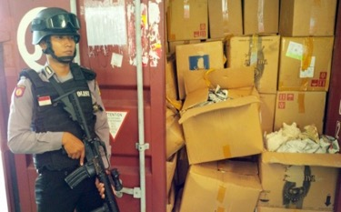
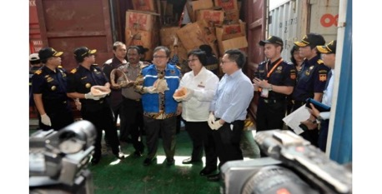
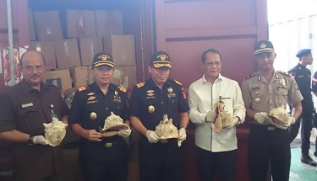
SIGNIFICANT ENFORCEMENT CASES
388 bales of shell of horned helmet (Cassis cornuta) (4,268 pcs and estimated to be worth IDR5.335 billion) that tried to be exported to China were seized in Jakarta by Tanjung Priok Customs and Jakarta Police

Slide 7
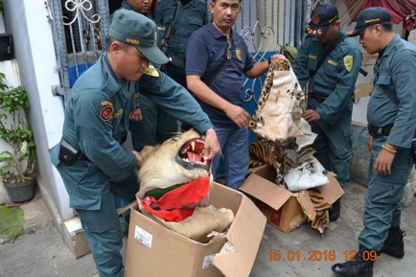
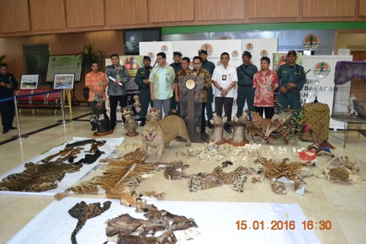
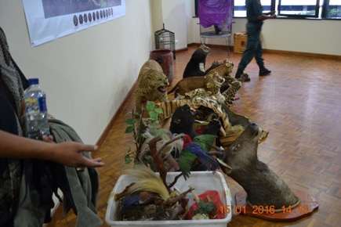
SIGNIFICANT ENFORCEMENT CASES
33 items of protected species and parts (Tigers, deers, snakes, cats, bears, birds, etc.) were seizured by SPORC Brigade Elang in DKI Jakarta provinces

Slide 8
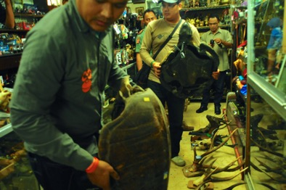
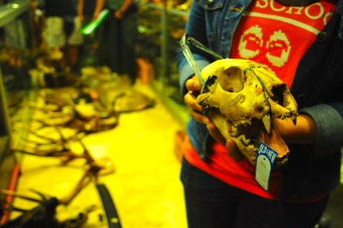
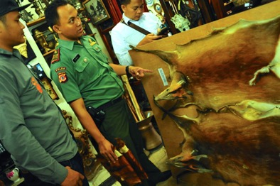
SIGNIFICANT ENFORCEMENT CASES
69 items of protected species and parts were seizured from a souvenirs shop in Bogor, West Java Province by Joint Team of West Java Conservation Agency, Centre for Orangutan Protection (COP) dan Jakarta Animal Aid Network (JAAN)

Slide 9
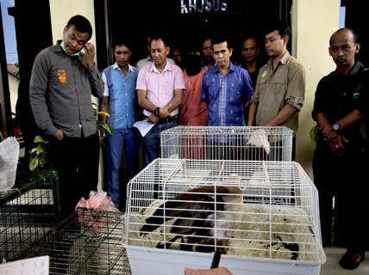
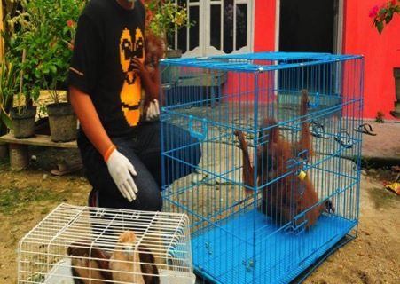
SIGNIFICANT ENFORCEMENT CASES
3 Orangutans, 2 eagles, Palm Cockatoo, 1 leopard were seizured from an online wildlife seller in Aceh Province by Joint Team of Aceh Conservation Agency, Aceh Police Agency, COP, and Orangutan Information Centre (OIC)
Suspect was punished with 2 years of inprisonment

Slide 10
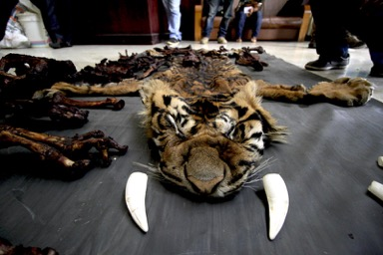
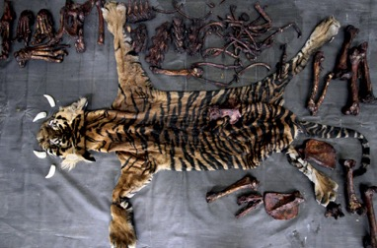
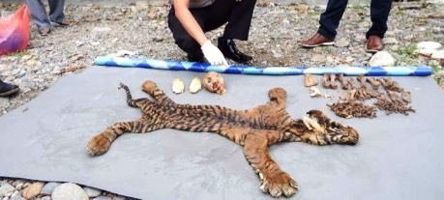
SIGNIFICANT ENFORCEMENT CASES
Skin Tiger and parts (Panthera tigris sumatrae) was seizure in Aceh Province by Gunung Leuser National Park, Aceh Tamiang Police Agency and WCS WCS
Two suspects were arrested → local forestry officers who involved in the illegal trade syndicate

Slide 11
CHALLENGES
Dificulties to optimize ASEAN-WEN National Task Force in Indonesia in order to combat wildlife crime
Forestry officer (Forest Ranger) has limited authority to do inspection at sea port and airport (CIQ area)
Establish agreement among law enforcement authorities to include illegal wildlife trade as an extraordinary crime
Online selling of protected wildlife species is increasing in which involves transnational network/ syndicate causes difficulties to be traced

Slide 12
RECOMMENDATIONS AND FUTURE PLANS
Coordination strengthening at national level among MoEF, Police, Customs, Quarantine, Prosecutors, and Courts through formal cooperation.
Establish joint intelligence and joint partol among bordering countries;
Syncronizing regional wildlife trade and information sharing system among ASEAN countries;
Technical assistance and join capacity building program in combatting wildlife crime among ASEAN countries; and
Construction of law enforcement system which consists of effective policy and legislation at international level and effective law enforcement at national and regional level

Slide 13
TERIMA
KASIH

